Slide 1



AI and the Future of Mediation
Colin Rule, CEO, ODR.com

Slide 2


Online Dispute Resolution is the use of information and communications technology to help parties resolve their disputes.

Slide 3

Meet the Fourth Party
A partner in resolutions
Lightens administrative loads
Saves money
Builds credibility
Becoming more capable all the time
Always in the parties’ pockets
Able to do things humans can’t (or shouldn’t) do

Slide 4
What can the fourth party do today?
Intake / Diagnosis
Processing Payments
Case administration
Notifications
Document management
Calendars / Scheduling
Assisted negotiation

Slide 5
What will the fourth party do tomorrow?
Research
Case evaluation / ZOPA
Coaching
Reframing / BATNA
Enforcement
Document drafting & submission
Automated negotiation

Slide 6
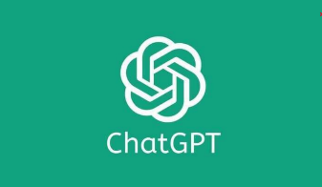



Slide 7
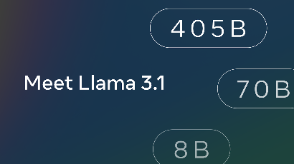
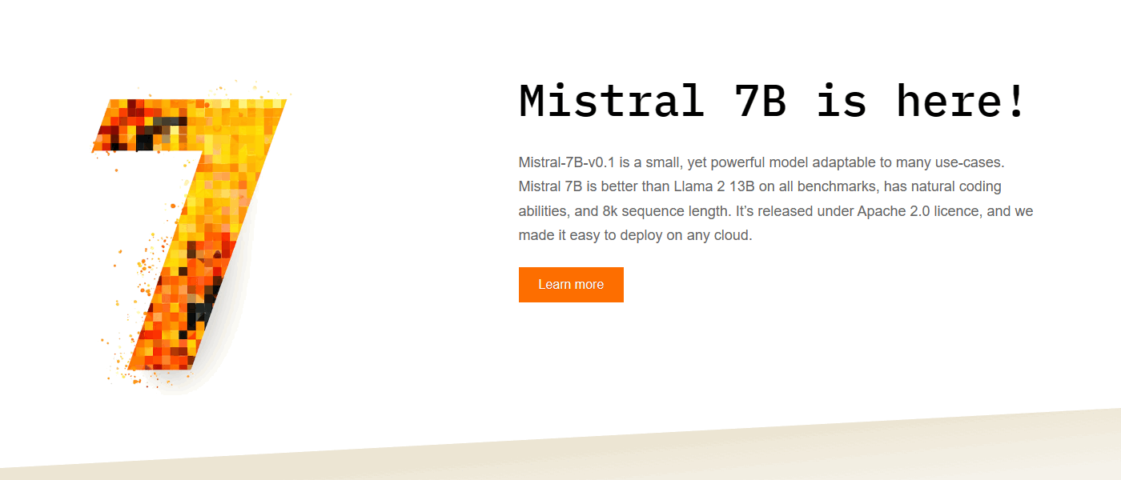
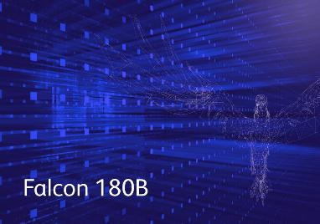






Slide 8
Potential for RAG LLMs and ODR
Document queries for all documents uploaded into a workspace
AI assisted case filing (natural language)
AI assisted document generation (creating draft settlement agreements)
AI assisted panelist search
AI tone monitoring - communication de-toxifying
AI mediator - AI asking questions, reframing, urging toward settlement
AI arbitrator - evaluates evidence, asks questions, renders decision
Notes:
These new technologies have a great potential but also pose challenges that are more than the technology itself.

Slide 9
Benefits
Challenges
Reduce cost of service
Provide faster service
Provide better service
Serve more people
Data & Privacy
Safety
Regulations
Ethics
Our parties will soon use these tools in every area of their lives, and they will expect to use them in their dispute resolution processes as well
Notes:
These new technologies have a great potential but also pose challenges that are more than the technology itself.

Slide 10
Platform Demo

Slide 11
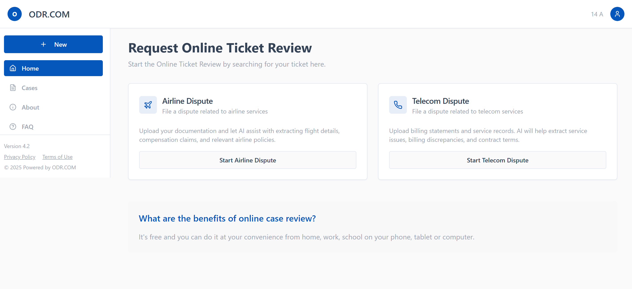

Slide 12
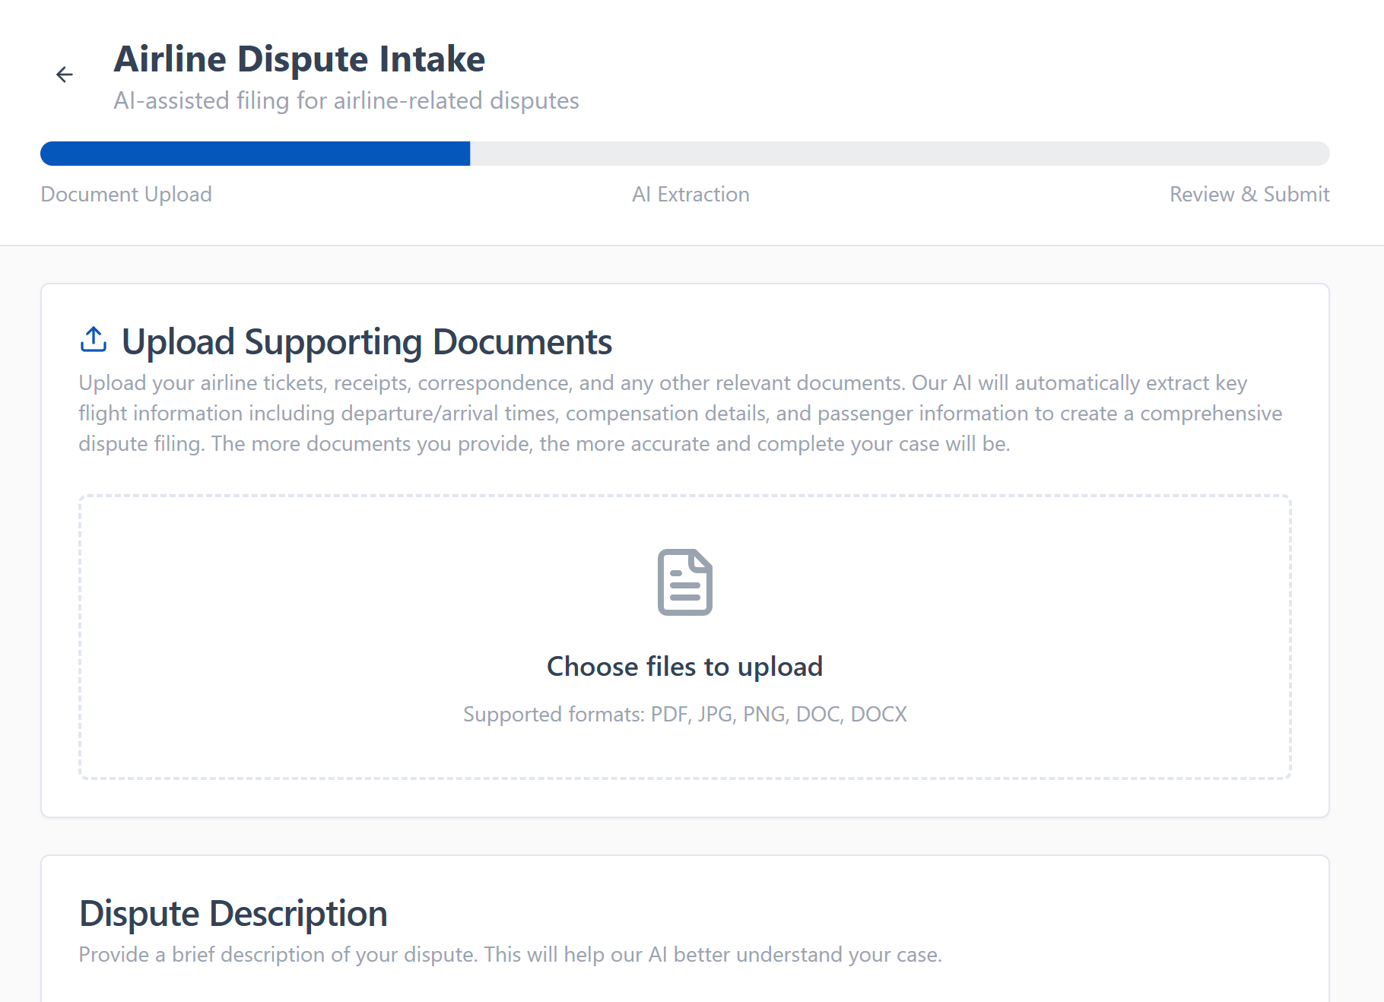

Slide 13
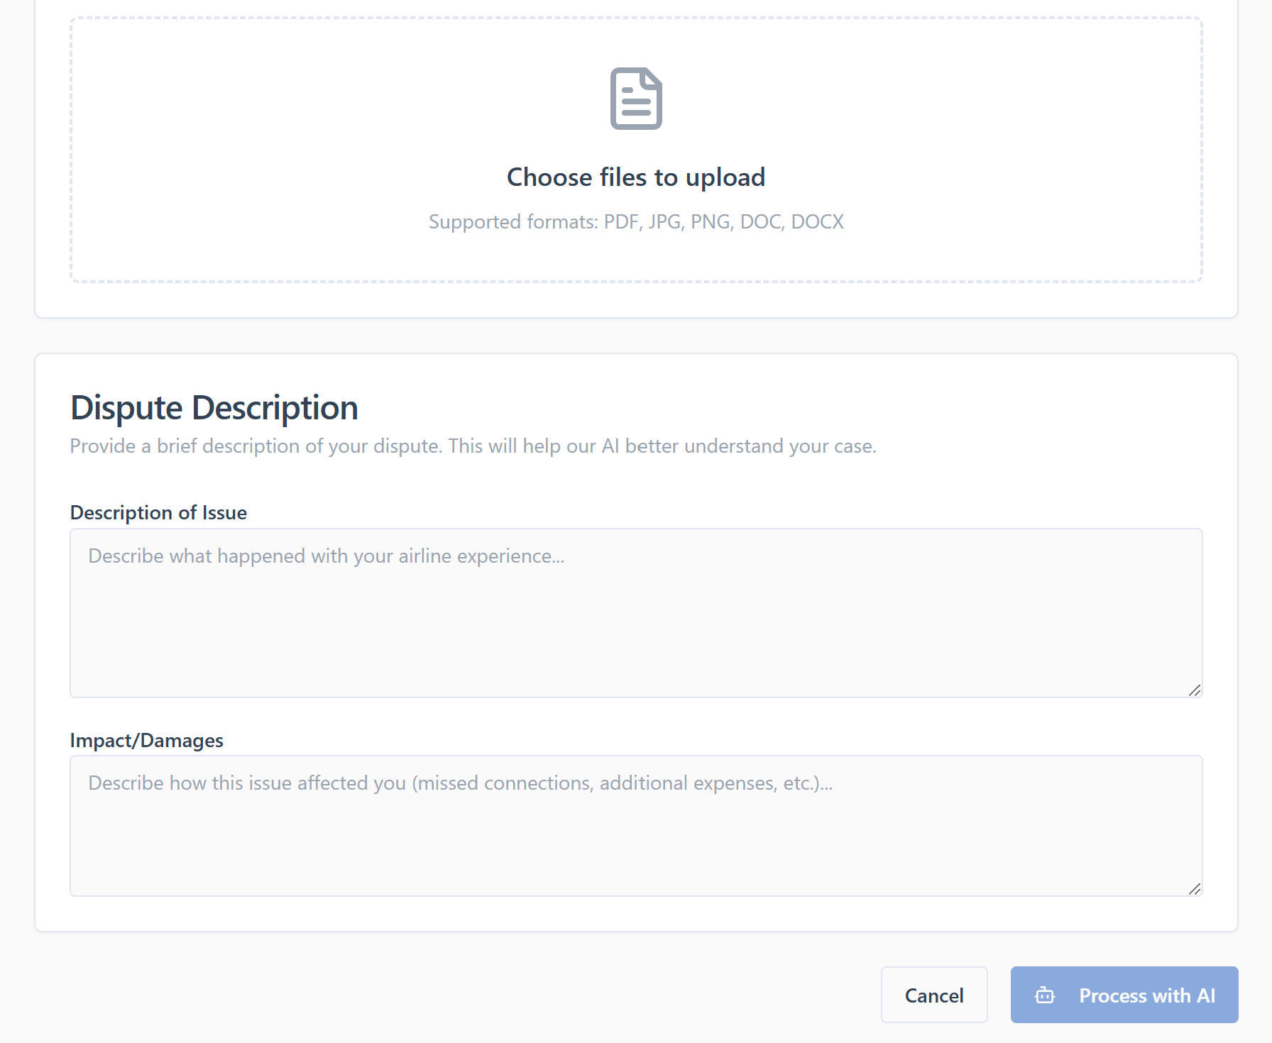

Slide 14
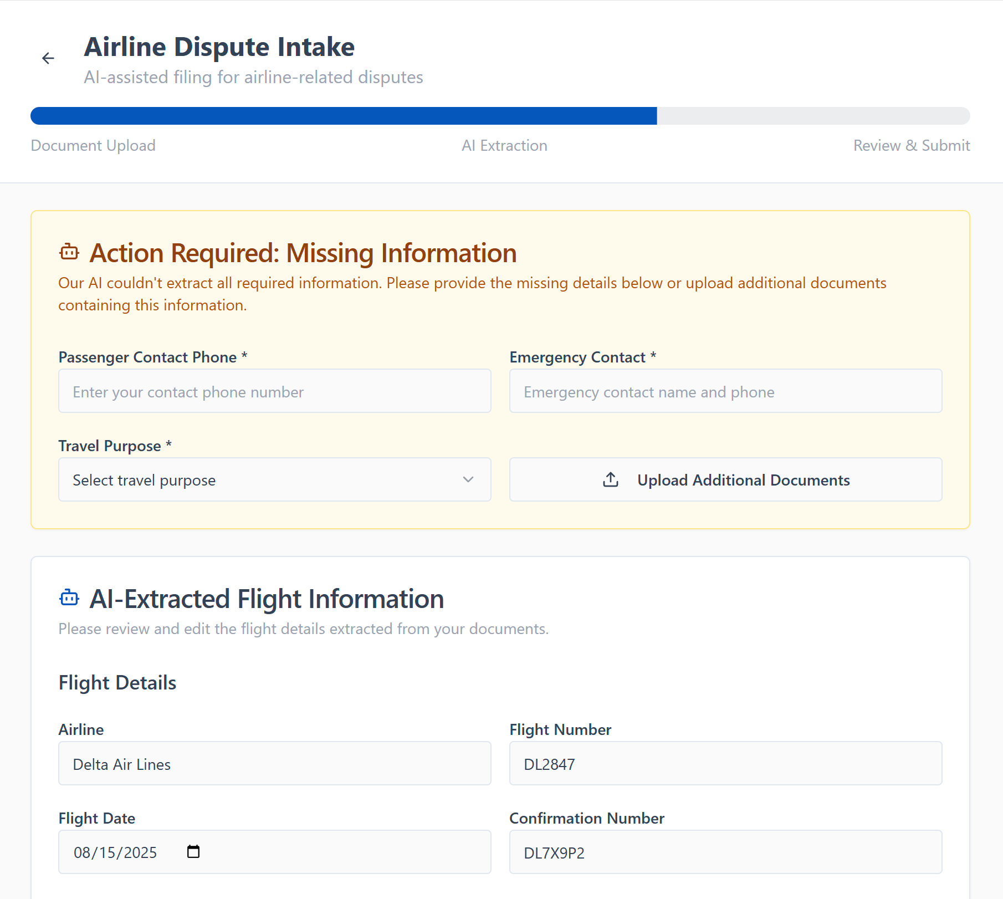

Slide 15
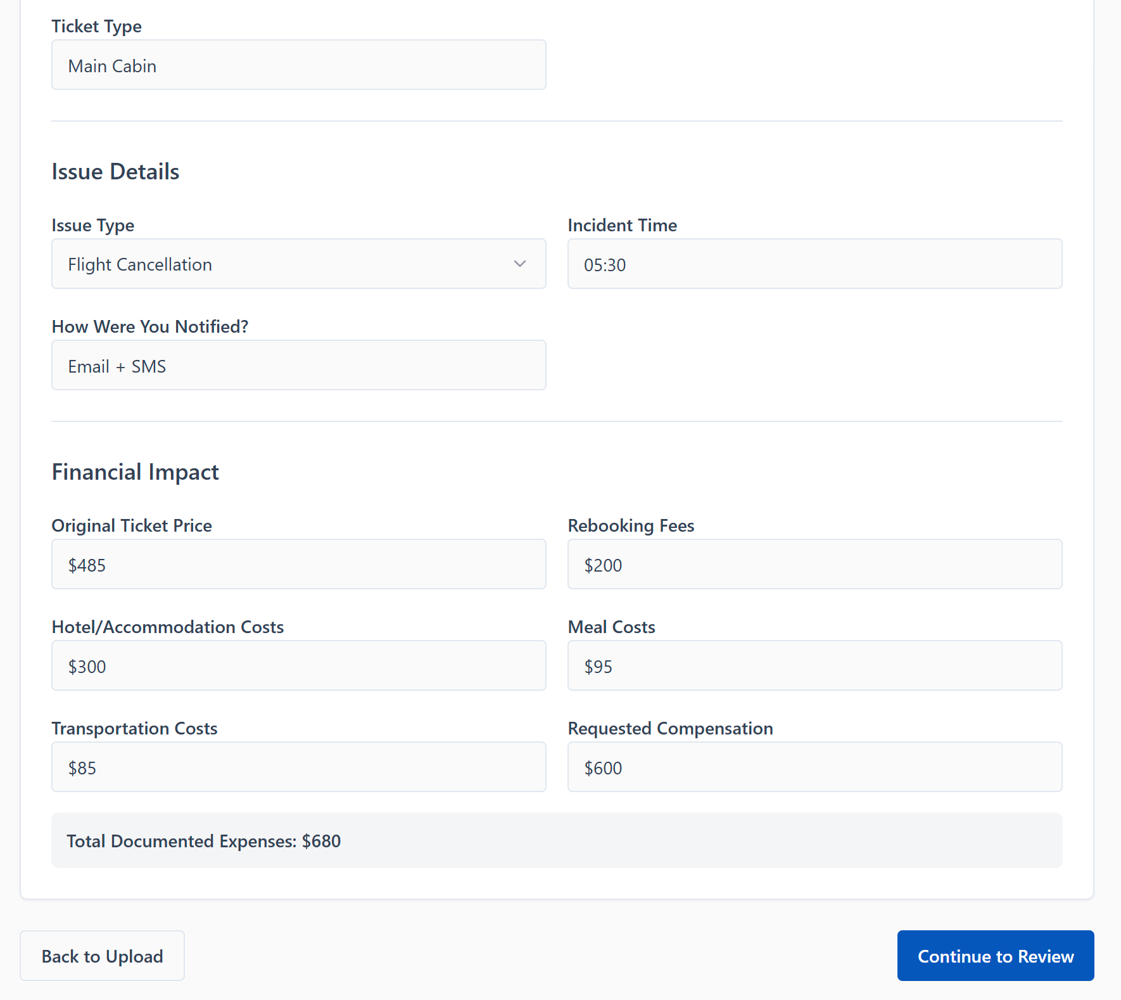

Slide 16
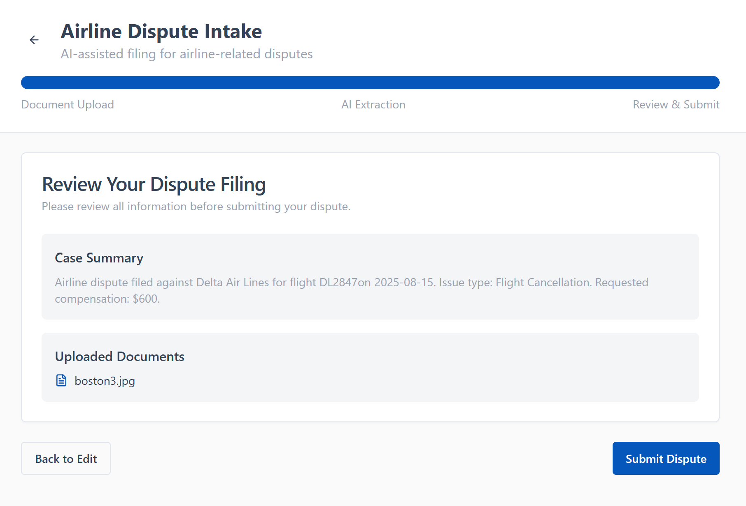

Slide 18
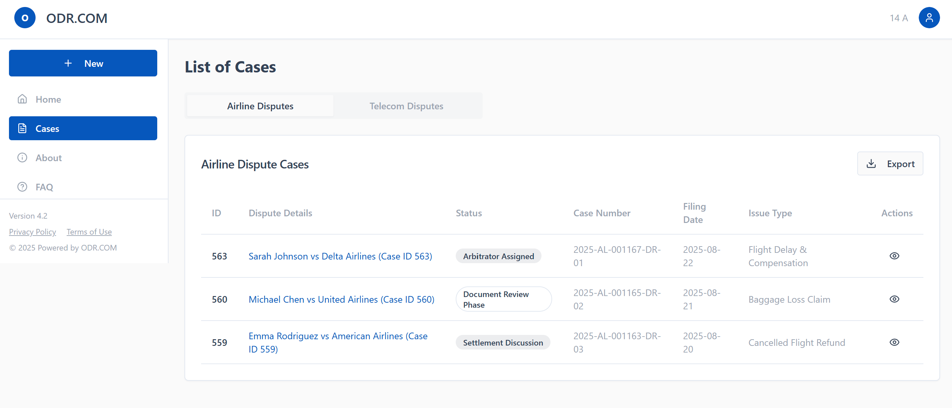

Slide 19
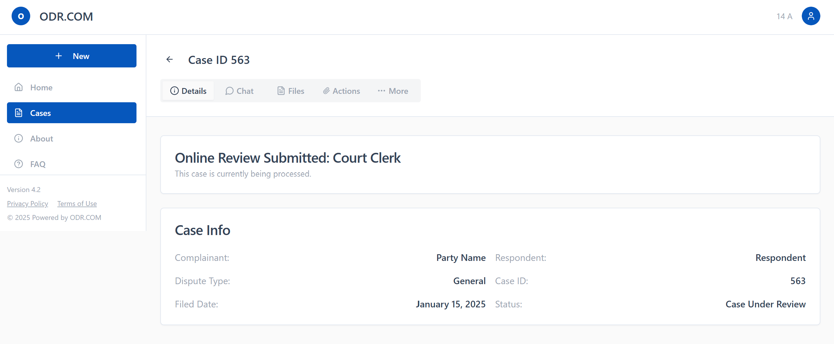

Slide 20
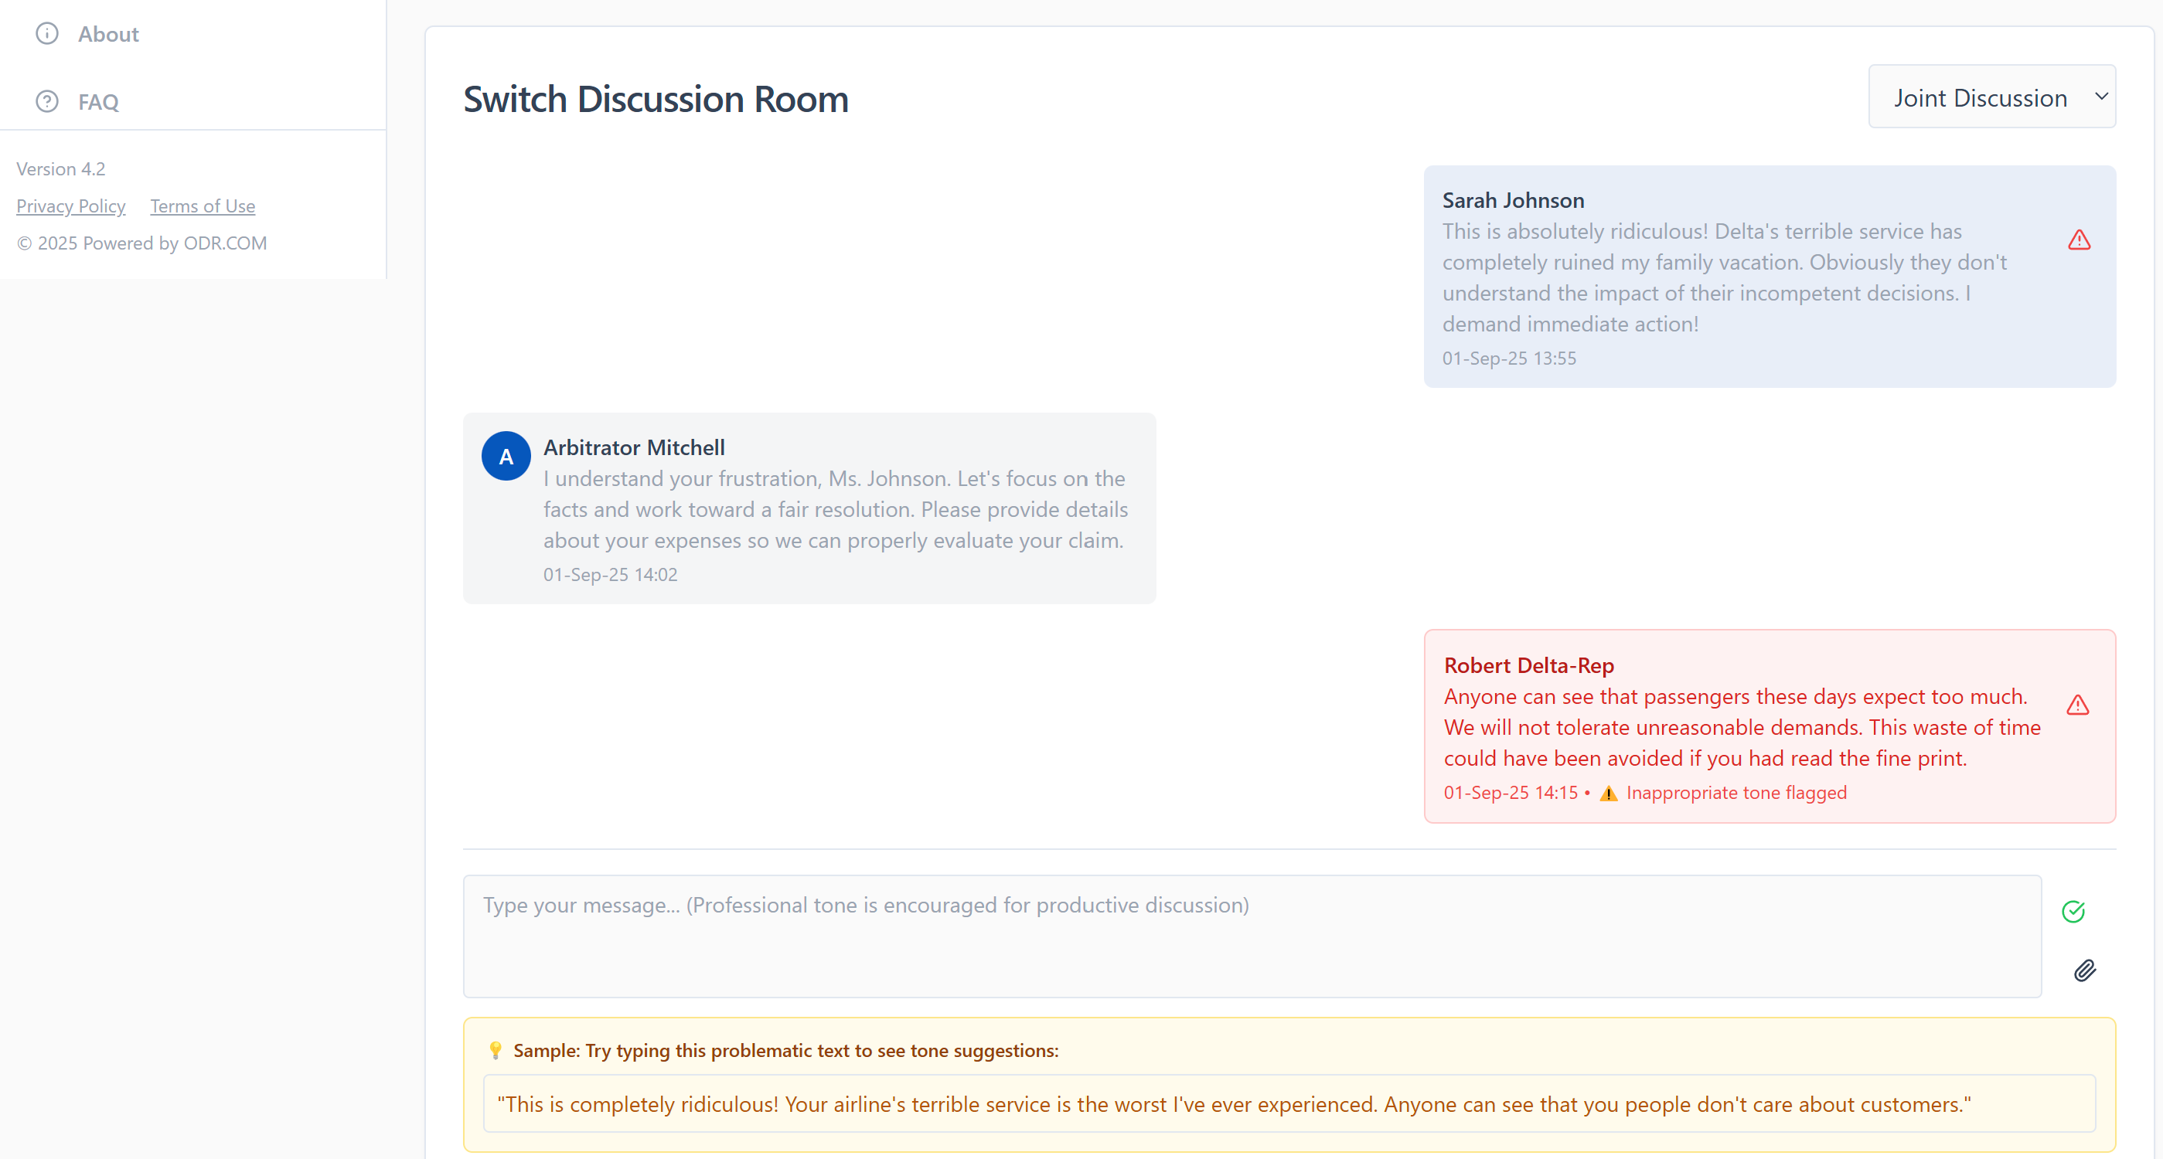

Slide 21
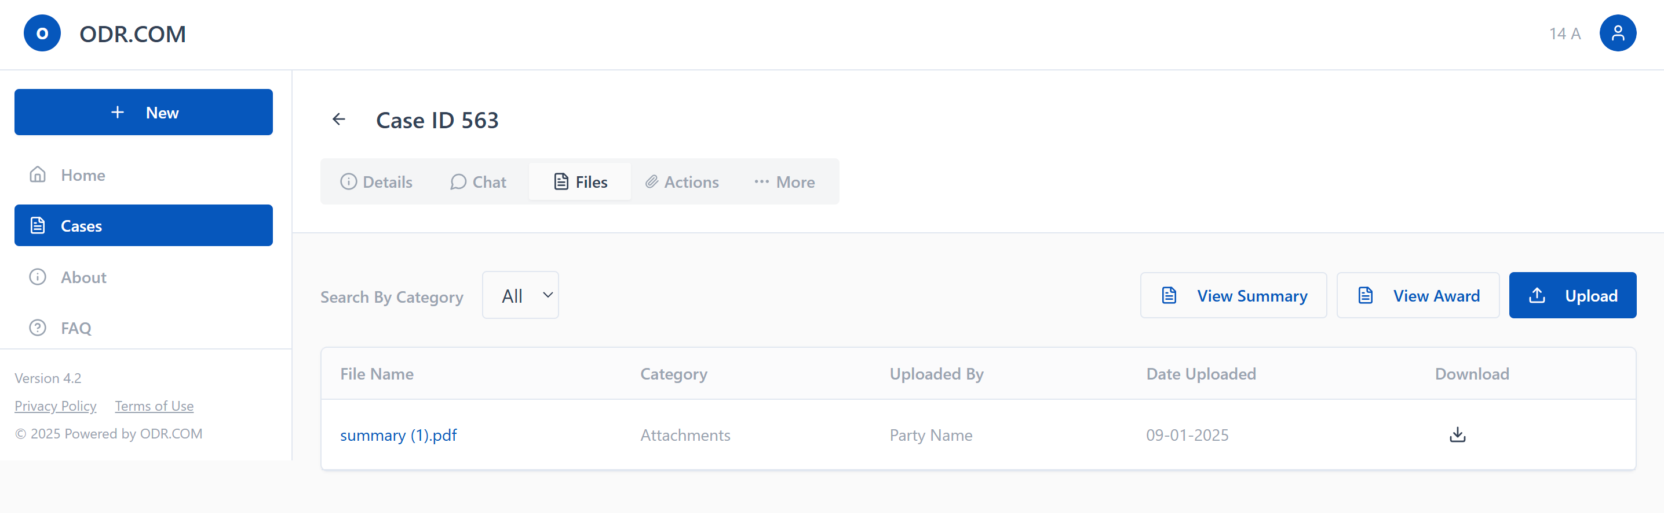

Slide 22
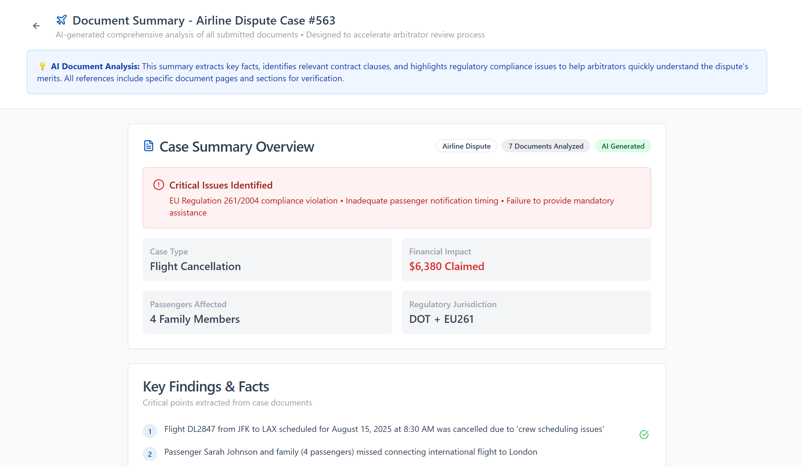

Slide 23
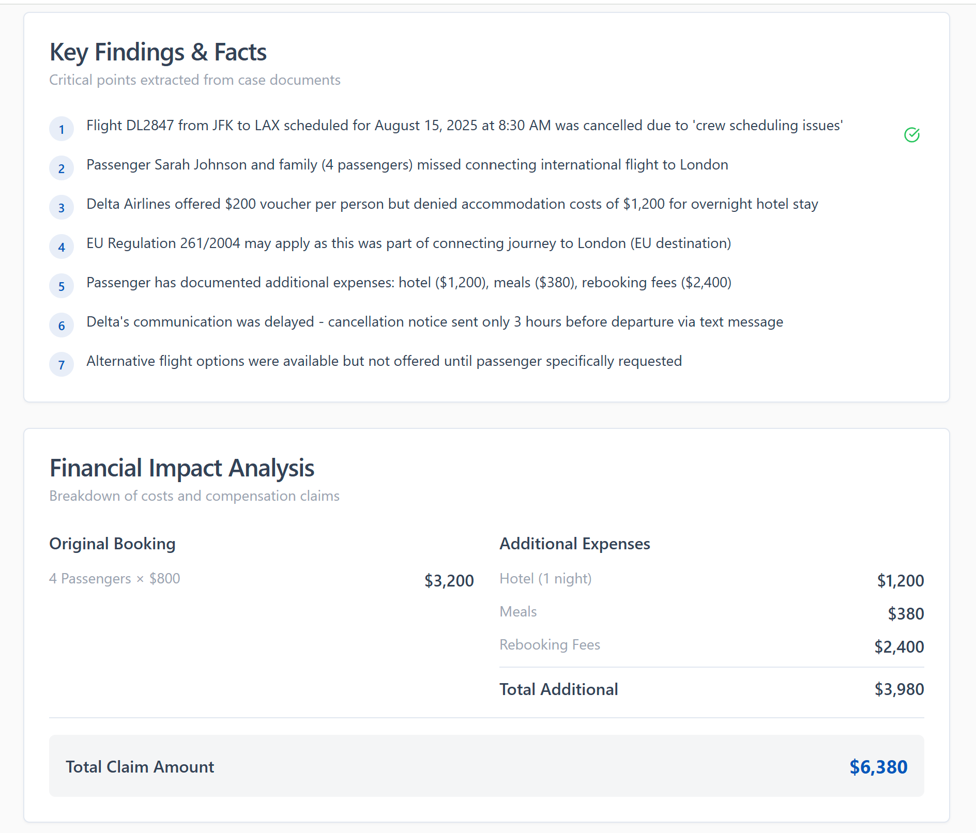

Slide 24
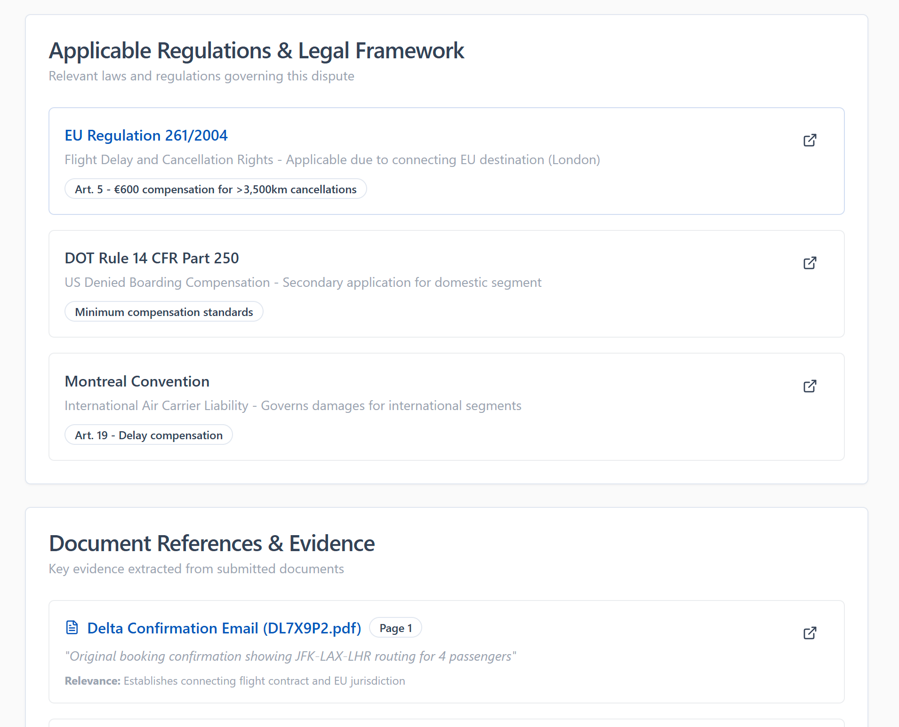

Slide 25
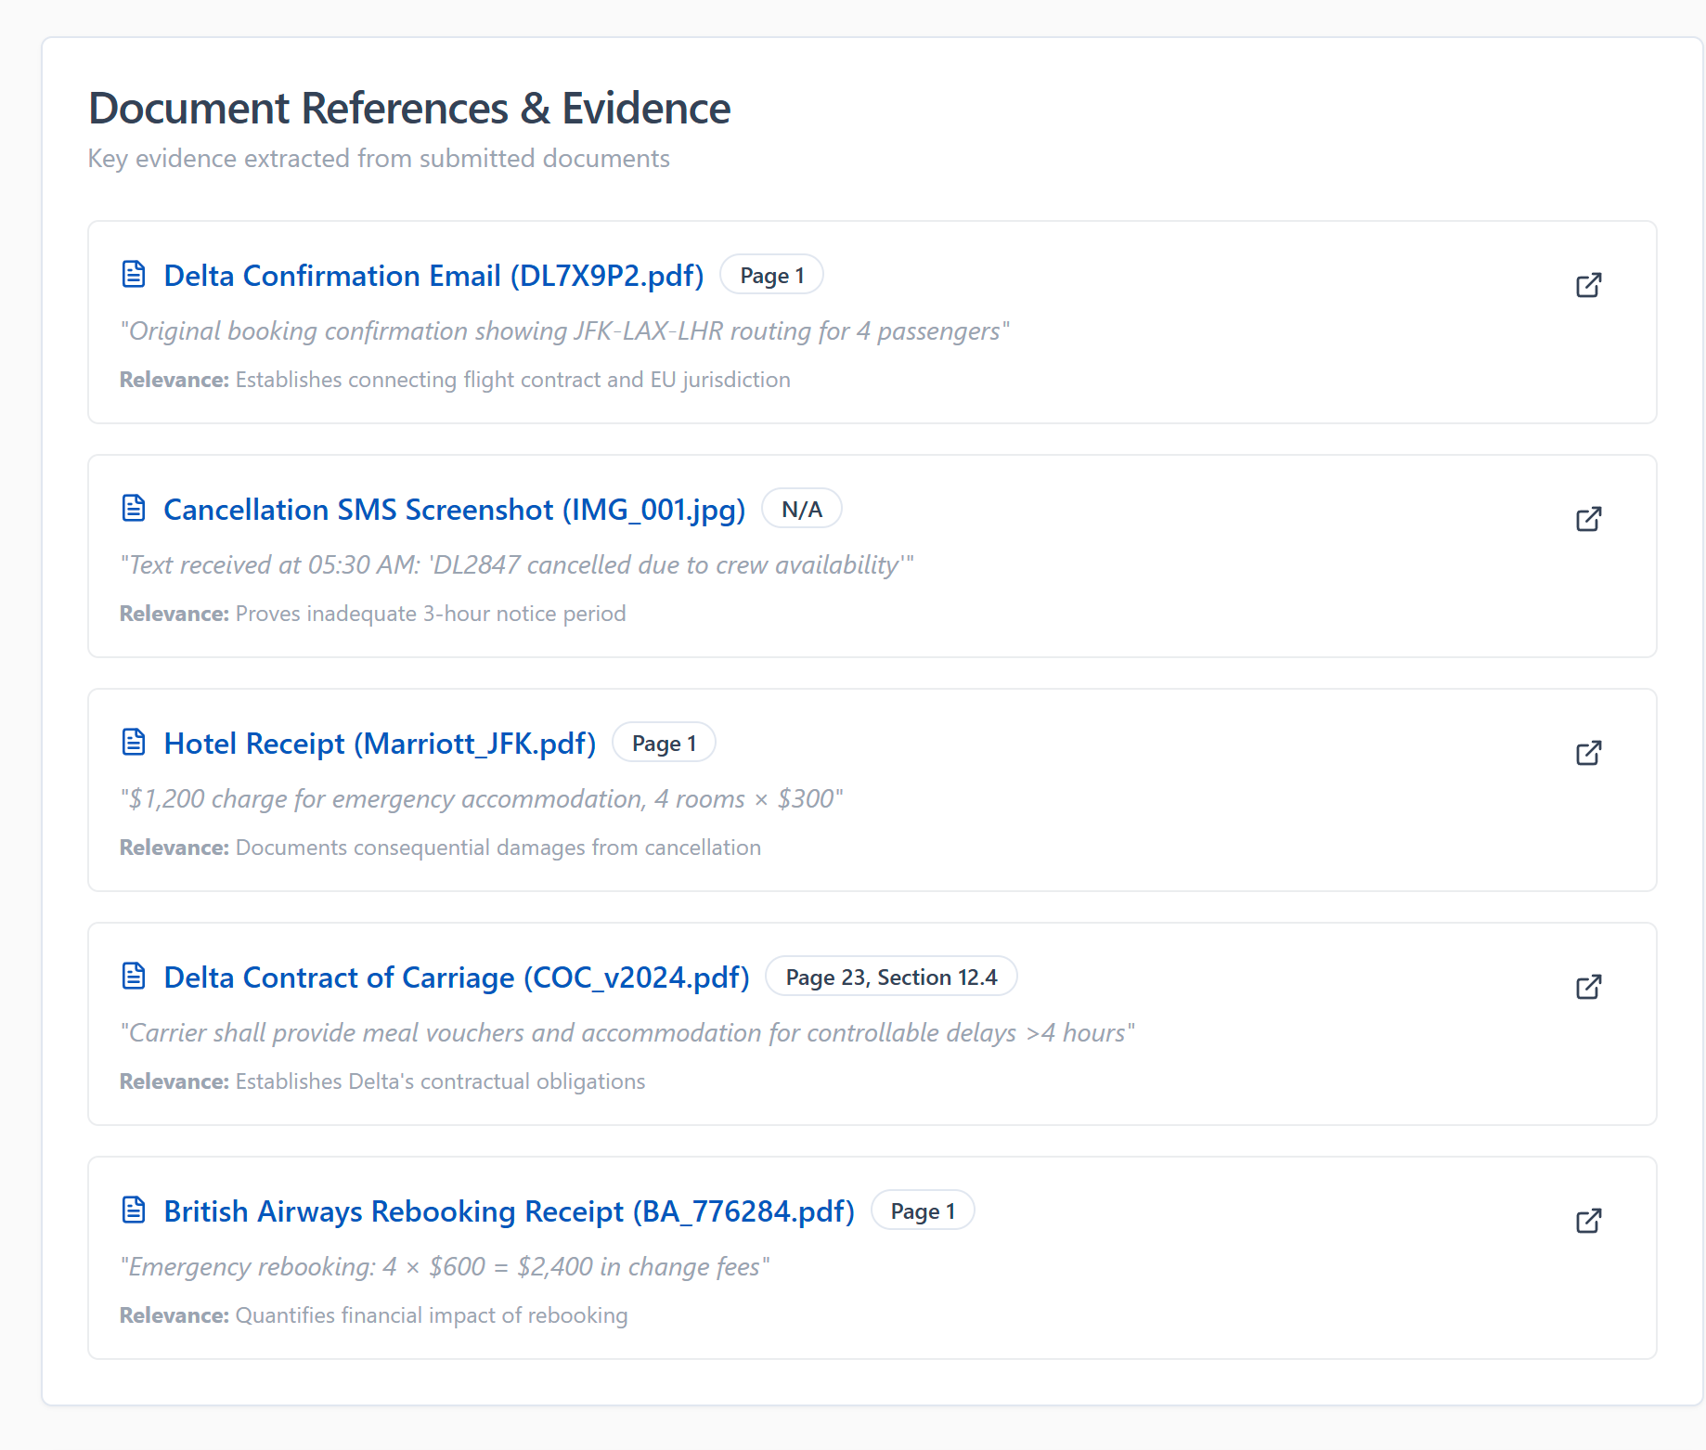

Slide 26
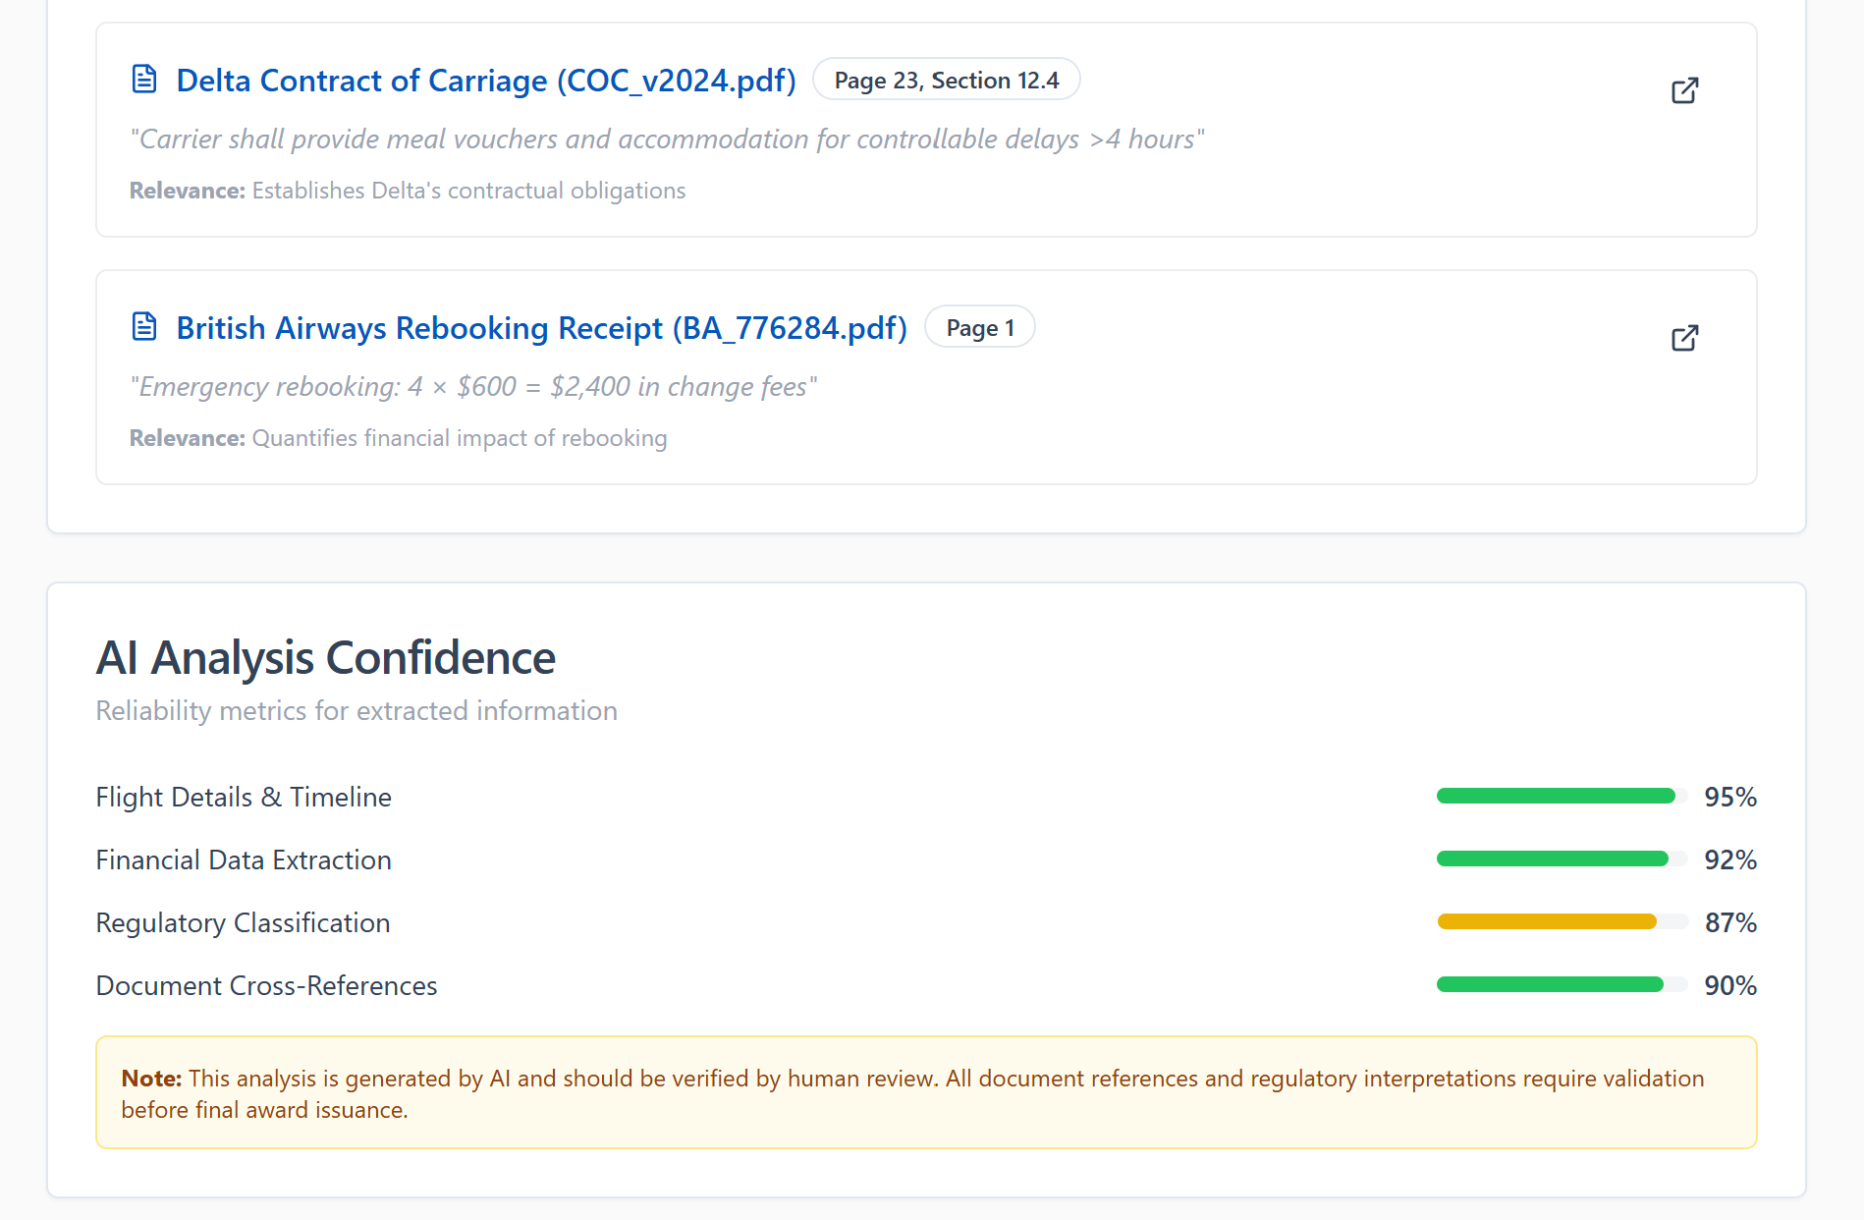

Slide 27
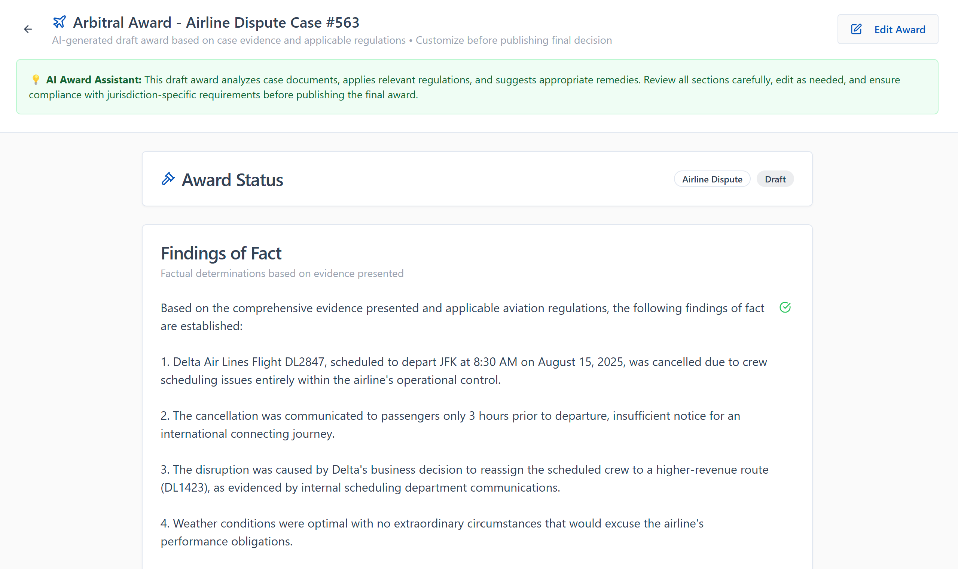

Slide 28
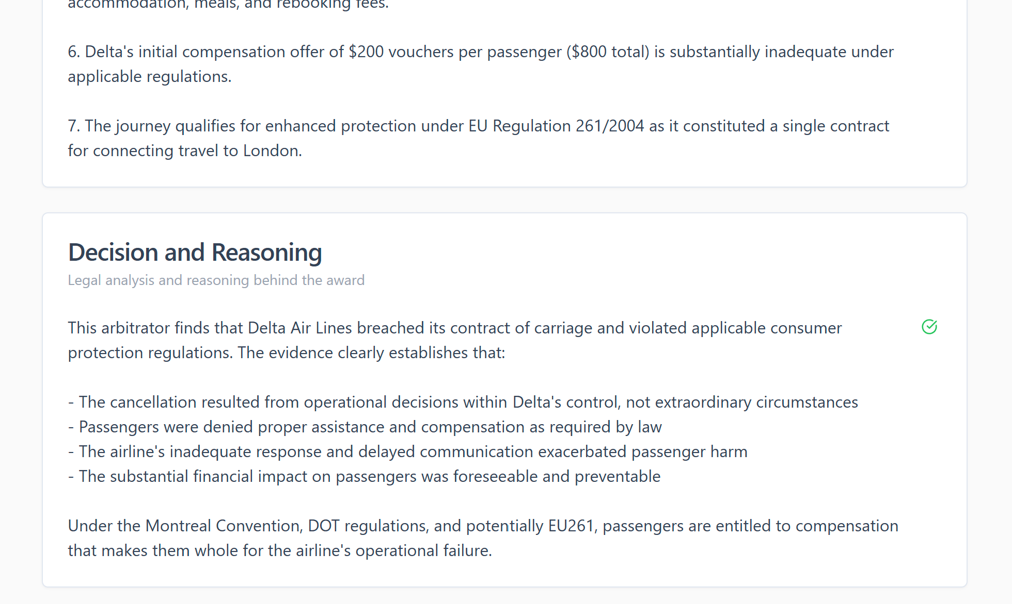

Slide 29
